Slide 1
CIS 4930/6930-002 Data Visualization
DATA ABSTRACTION
Paul Rosen
Assistant Professor
University of South Florida
slides credits Miriah Meyer (U of Utah)

Slide 2
http://www.vislies.org/

Slide 3
http://www.vislies.org/

Slide 4
http://www.vislies.org/

Slide 5
http://www.vislies.org/

Slide 6
data abstraction
the what part of an analysis that pertains to the data
translation of domain-specific terms into words that are as generic as possible

Slide 7
TYPE vs SEMANTIC

Slide 8
data types
Items
Attributes
Links
Positions
Grids

Slide 9
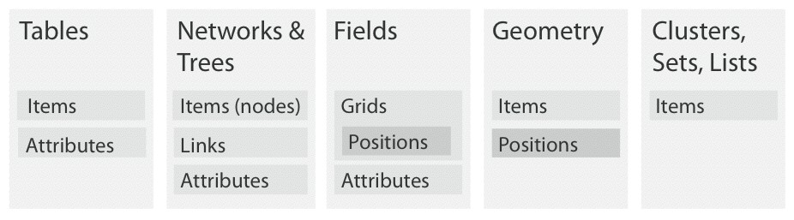
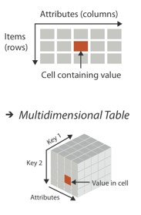
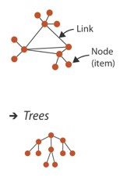
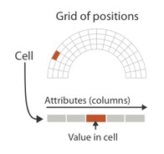
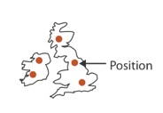
dataset types

Slide 10
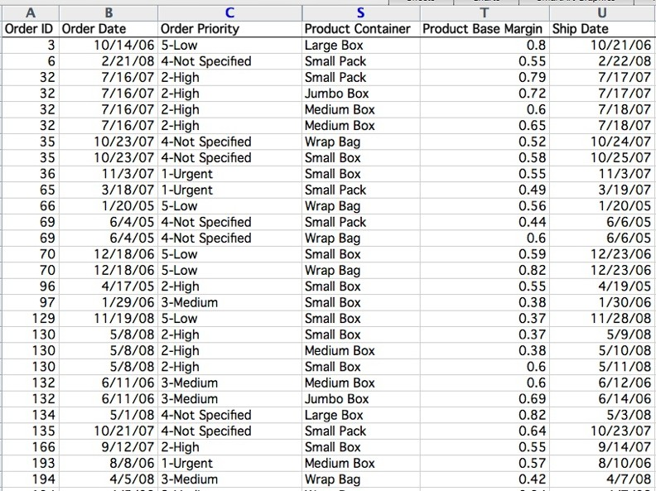

attribute
22
Field
cell
item

Slide 11
dataset types

Slide 12
dataset types

Slide 13
dataset types

Slide 14


Slide 15
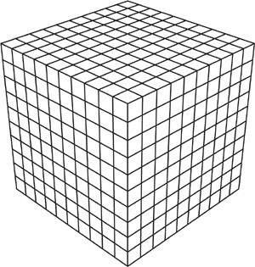

Slide 16
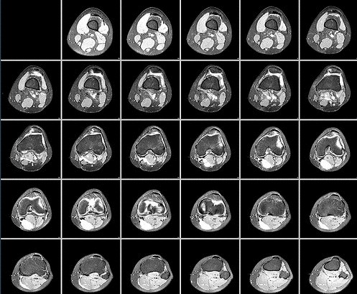

Slide 17
grid types
structured
unstructured
uniform
rectilinear

Slide 18
grid choices impact how continuous data is interpreted
two key considerations:
Sampling – the choice of where attributes are measured
Interpolation – how to model the attributes in the rest of space

Slide 19
dataset types

Slide 20
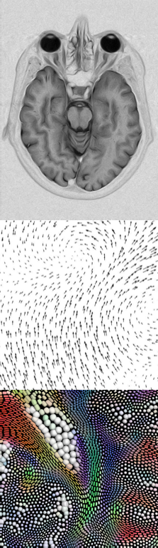
dataset types
scalar
vector
tensor

Slide 21
dataset types
scalar
vector
tensor

Slide 22
dataset types
scalar
vector
tensor

Slide 23
dataset types

Slide 24
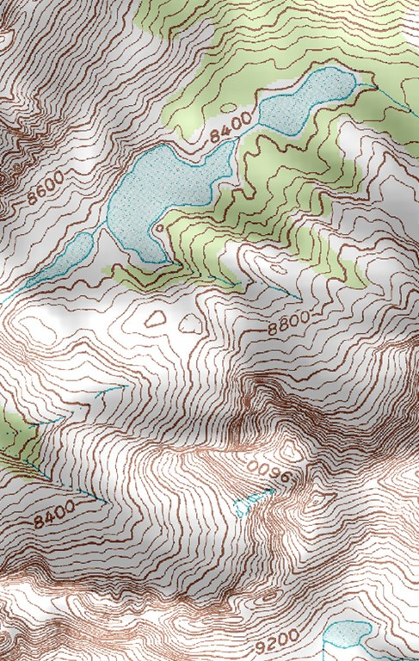
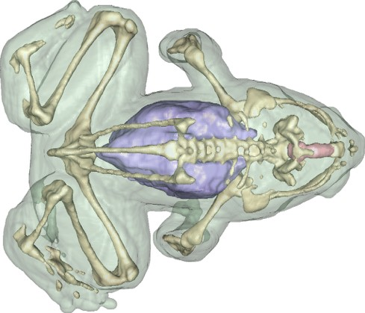
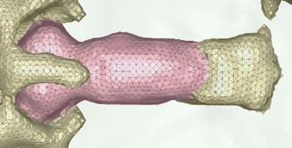

Slide 25
dataset types

Slide 26



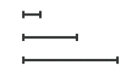
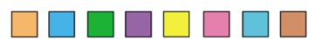

attribute types
Categorical
no implicit ordering
Ordinal
Ordered
Quantitative
meaningful magnitude
(can do arithmetic)

Slide 27
attribute types
Categorical
no implicit ordering
Ordinal
Ordered
Quantitative
meaningful magnitude
(can do arithmetic)

Slide 28
attribute types
Categorical
no implicit ordering
Ordinal
Ordered
Quantitative
meaningful magnitude
(can do arithmetic)

Slide 29
attribute types
Categorical
no implicit ordering
Ordinal
Ordered
Quantitative
meaningful magnitude
(can do arithmetic)

Slide 30
attribute types
Categorical
no implicit ordering
Ordinal
Ordered
Quantitative
meaningful magnitude
(can do arithmetic)

Slide 31
attribute types
Categorical
no implicit ordering
Ordinal
Ordered
Quantitative
meaningful magnitude
(can do arithmetic)

Slide 32


1 = Quantitative
2 = Nominal
3 = Ordinal
quantitative ordinal categorical

Slide 33
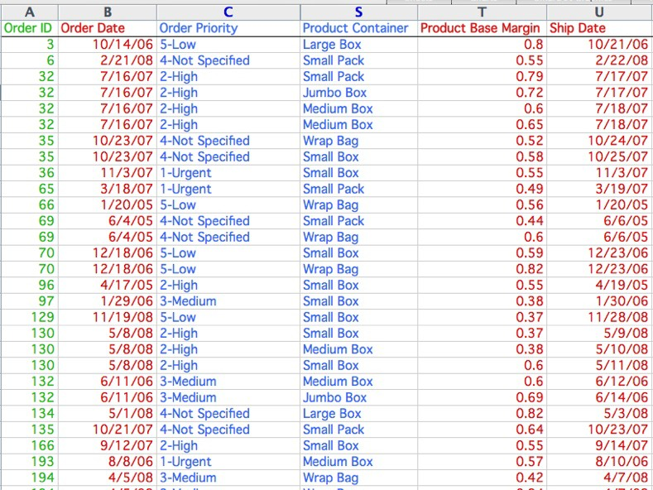

1 = Quantitative
2 = Nominal
3 = Ordinal
quantitative ordinal categorical

Slide 34
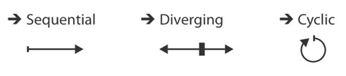
attribute types
Categorical
no implicit ordering
Ordinal
Ordered
Quantitative
meaningful magnitude
(can do arithmetic)
Sequential
Divergent
Cyclic

Slide 35
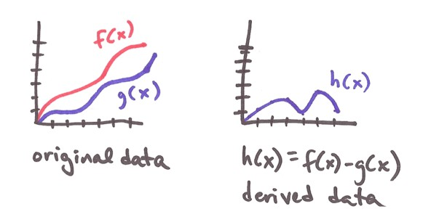
DERIVED ATTRIBUTES
derived attribute: computed from originals
simple change of type
acquire additional data
complex transformation
transformation is abstraction choice

Slide 36
DATA MODEL vs CONCEPTUAL MODEL
data model: mathematical abstraction (data abstraction)
set with operations, e.g. floats with * / - +
conceptual model: mental construction (semantics)
includes semantics, supports reasoning
conceptual model motivates data abstraction choices

Slide 37
EXAMPLE
from data model . . .
- 32.52, 54.06, -17.35, . . . (floats)
using conceptual model . . .
temperature
to new data abstraction…
continuous to 2 significant figures (quantitative)
hot, warm, cold (ordinal)
above freezing, below freezing (categorical)

